Slide 1
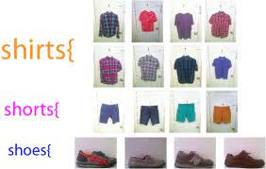
Outfit generator
Jarrett Arrington
Cant decide what to wear? Use the Outfit Generator!

